Slide 1

Project 3:
Rockbuster Stealth objectives
Rockbuster Stealth LLC, once a global leader in movie rentals, intends to introduce an online video rental platform to compete with streaming industry giants such as Netflix and Amazon Prime
Objectives
• Deliver data-driven insights to help the Rockbuster Stealth LLC management team strategically launch their new online video rental service.
Methods
PostgreSQL
Data Cleaning & Filtering
Joining Tables
Subqueries & CTEs
Data Visualization

Slide 2
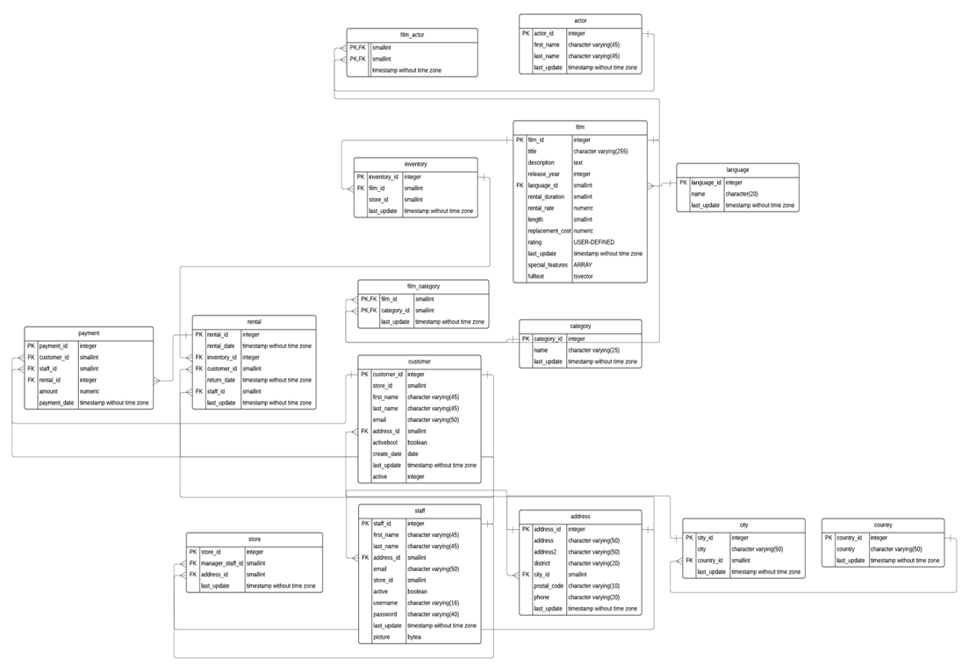
Rockbuster Stealth ERD & Statistics

Slide 3
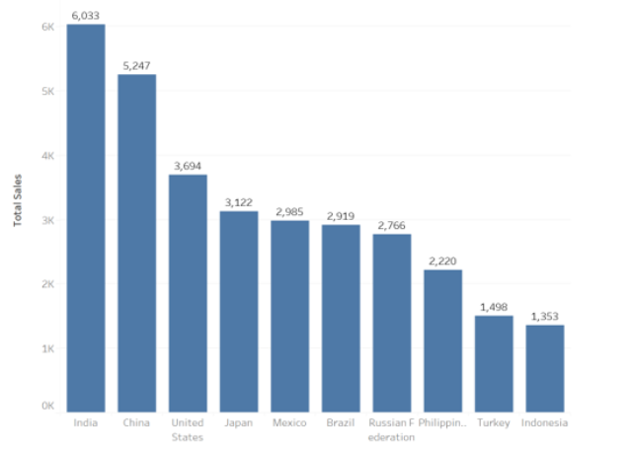
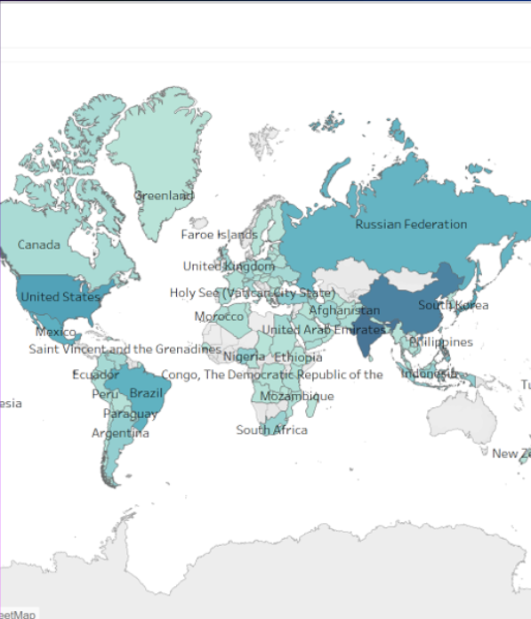
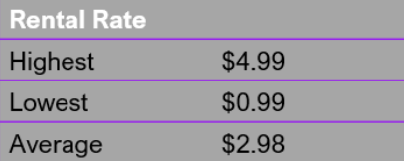
Rockbuster Analysis
The current rental service has the highest revenue in India and China
Sales show a variation across different geographic regions. Currently have sales in 108 countries

Slide 4
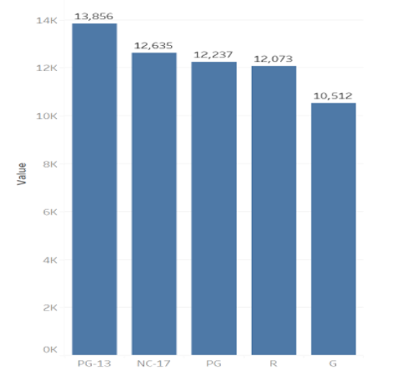
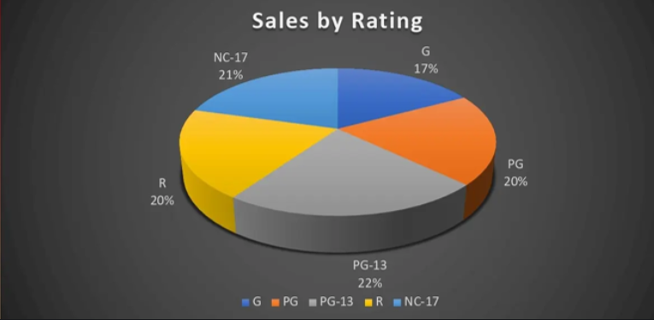
Rockbuster Analysis
PG-13 movies contributed the most revenue across all the genres
PG-13 has the most popular film rating

Slide 5
Rockbuster Recommendations
Market Focus
We recommend the digital platform be first launched in markets where Rockbuster already has an existing customer base, namely India, China and the United States of America.
These results suggest focusing marketing campaigns and resources on the genres, especially the PG-13 with the highest rating, with highest sales.
To reduce costs on movie licenses, consider discontinuing current movies with minimal or no rental history. This approach ensures a more efficient allocation of resources by focusing on movies that have a higher rental demand.

